Slide 1
Lecture 11 General Purpose GPU computing
GPCPU

Slide 2
Contents
GPUs: overview and history (already done)
GPU Architecture (already done)
CPU/GPU Interaction
Applications
Discussion
Summary

Slide 3
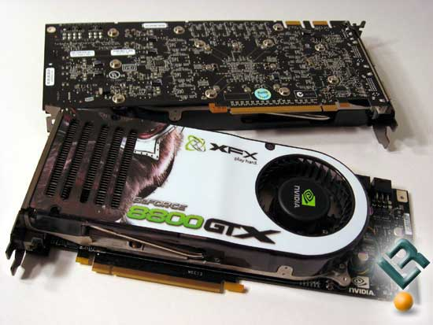
CUDA
In November 2006 NVIDIA released the first Direct X 10 GPU, the GeForce 8800 GTX.
This was the first GPU to be built with NVIDIA’s CUDA architecture

Slide 4
CUDA
The CUDA architecture added several new components designed strictly for GPU computing
every ALU on the chip could be used by a program for general-purpose computations.
ALUs implemented by using an IEEE standard
single precision floating point arithmetic included instruction sets
suitable for general computation

Slide 5
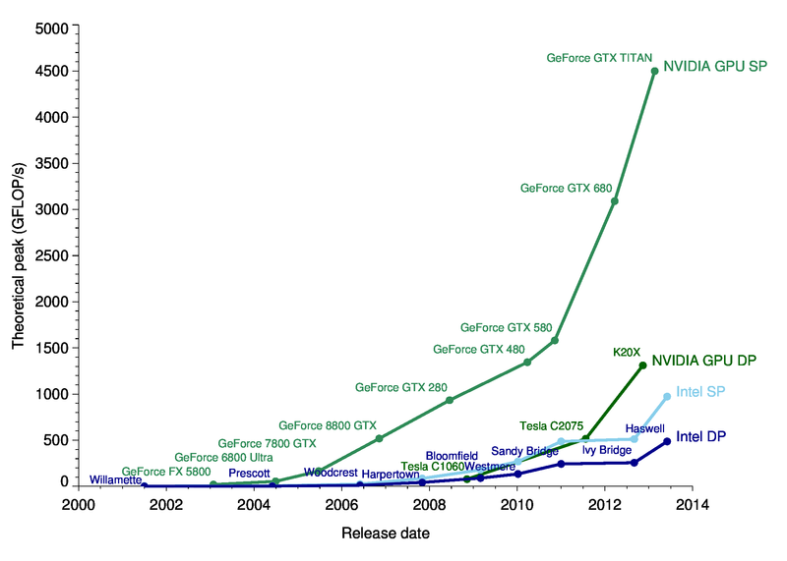
GPU vs CPU performance (2001-2014)
http://michaelgalloy.com/wp-content/uploads/2013/06/cpu-vs-gpu.png

Slide 6
OpenCL
“The open standard for parallel programming of heterogeneous systems”
Initially targeted for graphics cards, but also CPUs, DSPs, and more…
e.g. Allows parallel kernels to be run on CPU with SIMD instructions, or on GPU

Slide 7
OpenCL
Alternative to CUDA – non-proprietary
First released Nov. 2008
Managed by Kronos Group industry standardisation forum
https://www.khronos.org/opencl/

Slide 8
CPU/GPU Interaction

Slide 9
Using CPU and GPU
GPUs are designed as numeric computing engines
Program
Sequential part
Parallel part
CPU
GPU

Slide 10
Using CPU and GPU
Won’t perform well on some tasks on which CPUs are designed to perform well
Most applications will use both CPUs and GPUs
CPU - sequential parts, management, I/O
GPUs - numerically intensive (parallel)
parts
Program
Sequential part
Parallel part
CPU
GPU

Slide 11
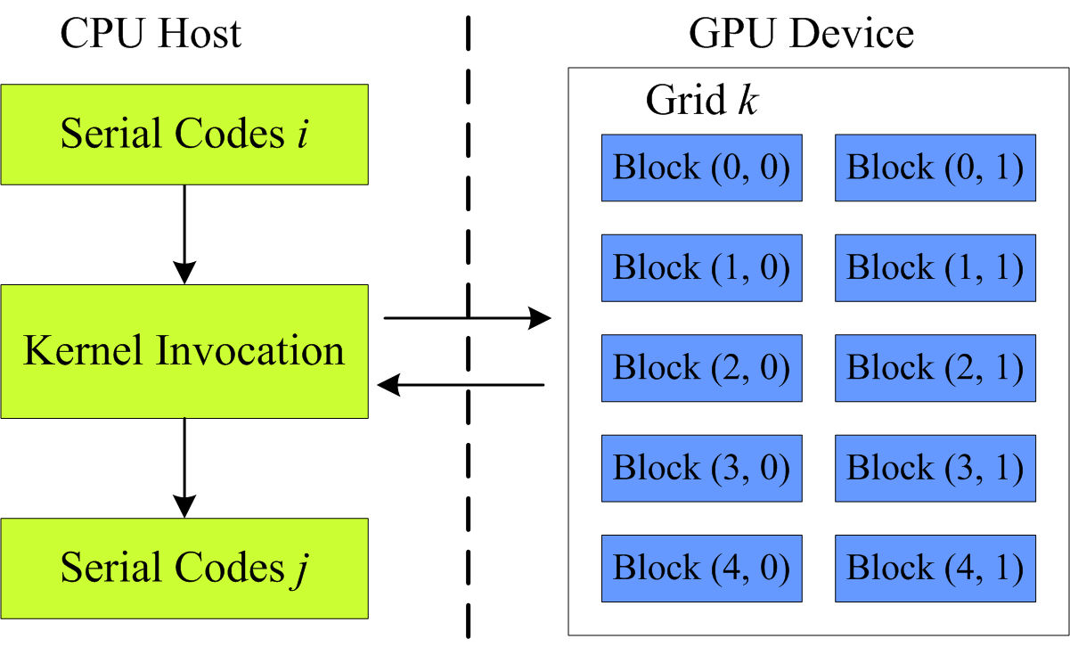
CPU/GPU interaction
The CPU is the Host, and runs the main program and any sequential code
The GPU is a compute device, which is attached to and managed by the host

Slide 12
CPU/GPU interaction
The basic unit of parallel execution is a kernel, roughly a C/C++ function
The host compiles and sends kernel(s) to the GPU
The GPU can execute many copies of a kernel at once, each on different data (work item)
The GPU schedule work items – like small threads – on the available SPUs (Stream Processing Unit)

Slide 13
CPU/GPU Interaction
The CPU and GPU work in parallel with each other

Slide 14
CPU/GPU Interaction
They communicate asynchronously via command queues or buffers
Care is needed to maintain synchronization
If command buffer becomes empty the GPU sits idle waiting for new input (CPU limited)
If the command buffer becomes full CPU sits idle waiting for GPU to consume data (GPU limited)
GPU reads commands
CPU writes commands
Pending GPU commands

Slide 15
Synchronisation issues between a CPU and GPU
Two approaches to dealing with synchronisation issues:
Inlining data: Inline all data to the command buffer, but bad for performance
Renaming data: Allocate a new data block and initialise

Slide 16
Memory
In general:
Kernels do not (often cannot) access main memory
Each kernel works with
its own private memory
plus some local memory (shared by a group of work items)
The application must move data explicitly between host, device, global and local memory
Note: compared to multi-core, a more complicated application model, but no single memory bottleneck

Slide 17
Applications

Slide 18

GPGPU Applications
Used in game physics calculations (physical effects like debris, smoke, fire, fluids)
Have also been used to accelerate non-graphical applications in computational biology, cryptography and other fields,
e.g.
Medical imaging
Computational fluid dynamics
Environmental science

Slide 19
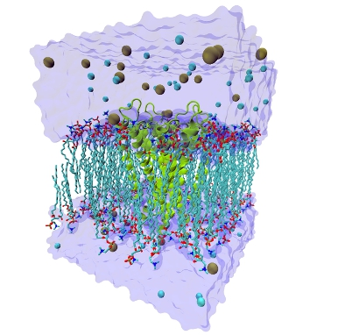

Applications
Molecular Biology Research Simulations:
The size of the biological system that can be simulated

Slide 20
Applications
A vast quantity of processing is necessary for HDTV.
It is a very parallel process as are 3D imaging and visualisation

Slide 21
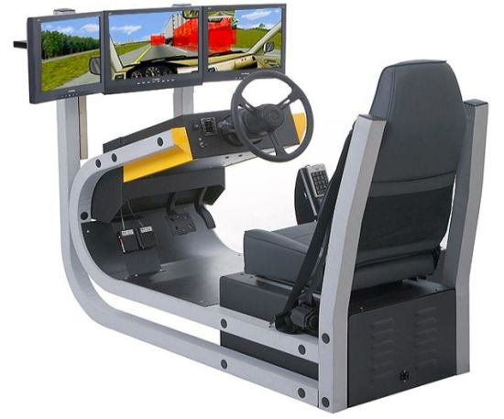
Applications
With increased computing speed games can be based on dynamic simulation rather than prearranged scenes.
Realistic modelling and simulation of physical effects - demand large amounts of computing power

Slide 22
Discussion

Slide 23
GPU or CPU ?
The level of speedup achieved over CPU execution reflects the suitability of the CPU to the application.
Most applications have portions that can be much better executed on the CPU
Some portions are easy to parallelize and so would benefit from being run on the GPU rather than the CPU

Slide 24
GPU or CPU ?
GPU computations can be much more energy-efficient than CPU
Simpler, e.g. No prediction, no cache, and slower clock
e.g. http://www.nvidia.co.uk/object/gcr-energy-efficiency.html suggests basic operations can be 10x more efficient
http://www.green500.org/sites/default/files/huang-hppac09-gpu.pdf - Just look at energy (forget Energy-Delay product)
=> lower power consumption / less heat
REALLY important for large computers & data centres

Slide 25
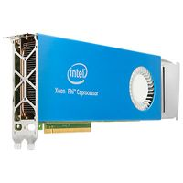
Other options and issues?
Other attached processor options
E.g. DSP, FPGA
Many-core CPUs now also available as add-on compute devices
E.g. Intel Xeon Phi, Many Integrated Core (MIC) architecture

Slide 26
Other options and issues?
E.g. Intel Xeon Phi, Many Integrated Core (MIC) architecture
50+ Intel cores on a single chip, packaged as a PCI card, ~£2,500
Each core supports 512 bits vector instructions, e.g. 16 single-precision operations at once (roughly like 16 SPEs)
Roughly 1 TFLOPS (double precision), and able to run arbitrary code on each core

Slide 27
Other options and issues?
Likely future convergence of GPU & CPU/multicore
E.g. shared memory support
In general, energy efficiency is a HUGE issue today, not just performance

Slide 28
Summary

Slide 29
Summary
A GPU is an attached processor, specialised for operations common to 3D graphics
Typically has several SIMD cores, each of which has many Stream Processing Elements (~ALUs)
Can execute many floating point operations at once (highly data parallel)
Has multiple memory areas with larger total bandwidth than main memory
More cost and energy efficient than a general-purpose CPU

Slide 30
Summary
Requires specialised programs:
The general purpose host sends work items via command queues to kernels (functions) that run in many parallel threads on the GPU (device)
(typically) no shared memory: requires memory movement to be programmed explicitly

